Slide 1

CSE (H) with specialization in Machine Learning and Artificial Intelligence
Soft Computing (CSF – 332)
Chapter -2.1
Introduction to Neural Network Models
By: Dr. Monika Singh E11032
DISCOVER . LEARN . EMPOWER

Slide 2
Course Objectives
To introduce soft computing concepts and techniques of artificial neural networks, fuzzy sets, fuzzy logic and genetic algorithms
To understand the various techniques from the application point of view.
To analyze various soft computing techniques and decide the technique to be used in a particular problem situation.
To implement soft computing based solutions for real-world problems

Slide 3
Course Outcomes
CO1 | Identify and describe soft computing techniques and their roles in building intelligent. Machines | 1
CO2 | Recognize the feasibility of applying a soft computing methodology for a particular problem. | 2,4
CO3 | Apply fuzzy logic and reasoning to handle uncertainty and solve engineering problems, genetic algorithms to combinatorial optimization problems and neural networks to pattern classification and regression problems. | 3
CO4 | Effectively use modern software tools to solve real problems using a soft computing approach. | 3
CO5 | Evaluate various soft computing approaches for a given problem. | 4

Slide 4
Table of Contents
Associative Memory Networks
Bidirectional Associative Memory (BAM)
Hopfield Networks
Self-Organizing Feature Maps: Kohonen Self-Organizing Feature Maps.

Slide 5
Introduction to Neural Network Models

Slide 6
AUTO-ASSOCIATIVE MEMORY NETWORK
Same as hetero-associative nets, except t(p) =s (p).
Used to recall a pattern by a its noisy or incomplete version. (pattern completion/pattern recovery)
A single pattern s = (1, 1, 1, -1) is stored (weights computed by Hebbian rule or outer product rule.

Slide 7
AUTO-ASSOCIATIVE MEMORY NETWORK – DIAGONAL ELEMENTS
Diagonal elements will dominate the computation when multiple patterns are stored (= P).
When P is large, W is close to an identity matrix. This causes output = input, which may not be any stoned pattern. The pattern correction power is lost.
Replace diagonal elements by zero.

Slide 8
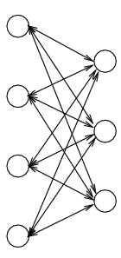
BIDIRECTIONAL ASSOCIATIVE MEMORY (BAM) NETWORK
Architecture:
Two layers of non-linear units: X-layer, Y-layer.
Units: discrete threshold, continuing sigmoid (can be either binary or bipolar).
Weights:
Symmetric:
Convert binary patterns to bipolar when constructing W.

Slide 9
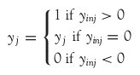
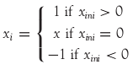
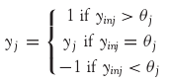
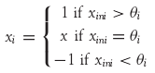
ACTIVATION FUNCTIONS IN BAM
The activation function is based on whether the input target vector pairs used are binary or bipolar.
Activation function for the Y-layer | Activation function for the X-layer
With binary input vectors | With binary input vectors
With bipolar input vectors | With bipolar input vectors

Slide 10
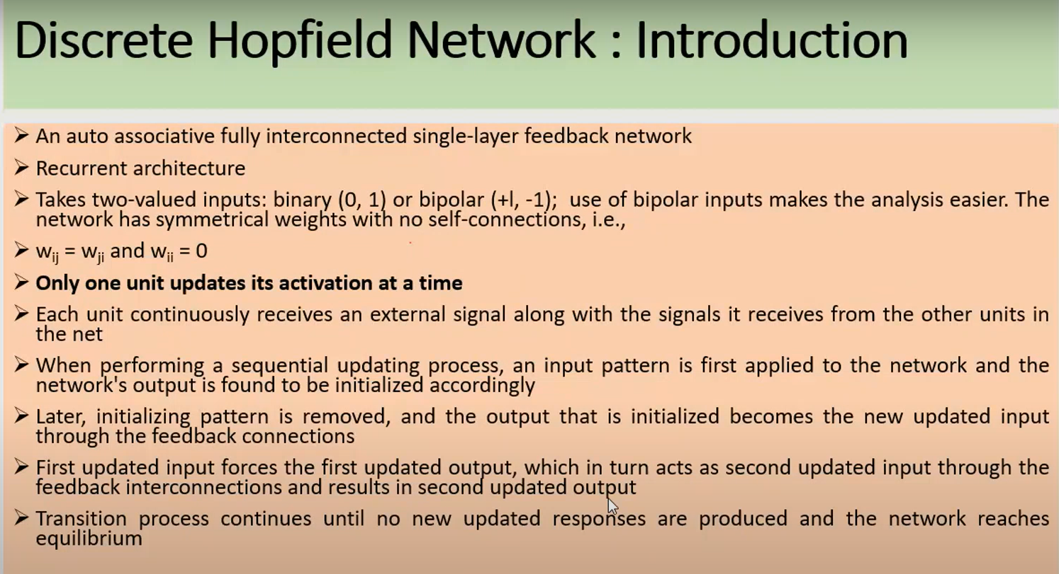

Slide 11
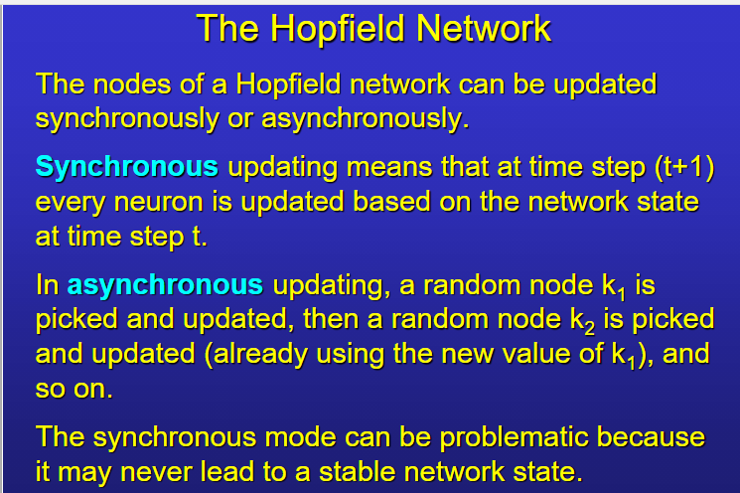

Slide 12
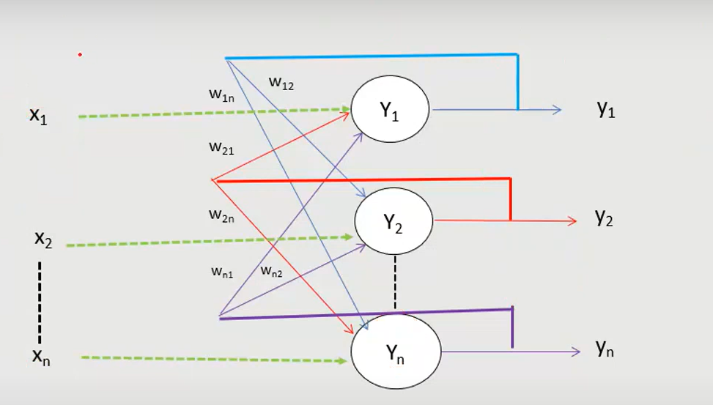

Slide 13
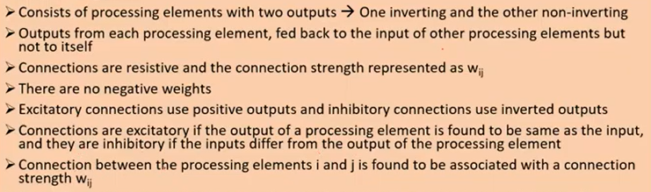

Slide 14
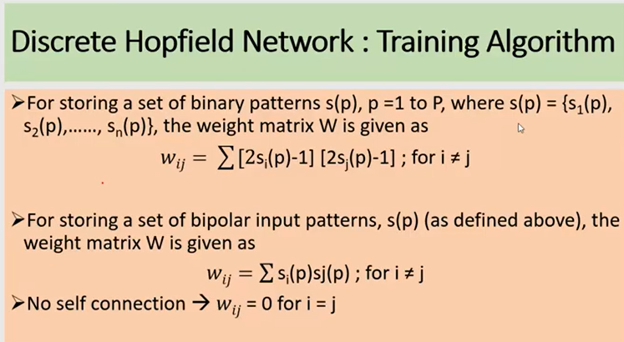

Slide 15
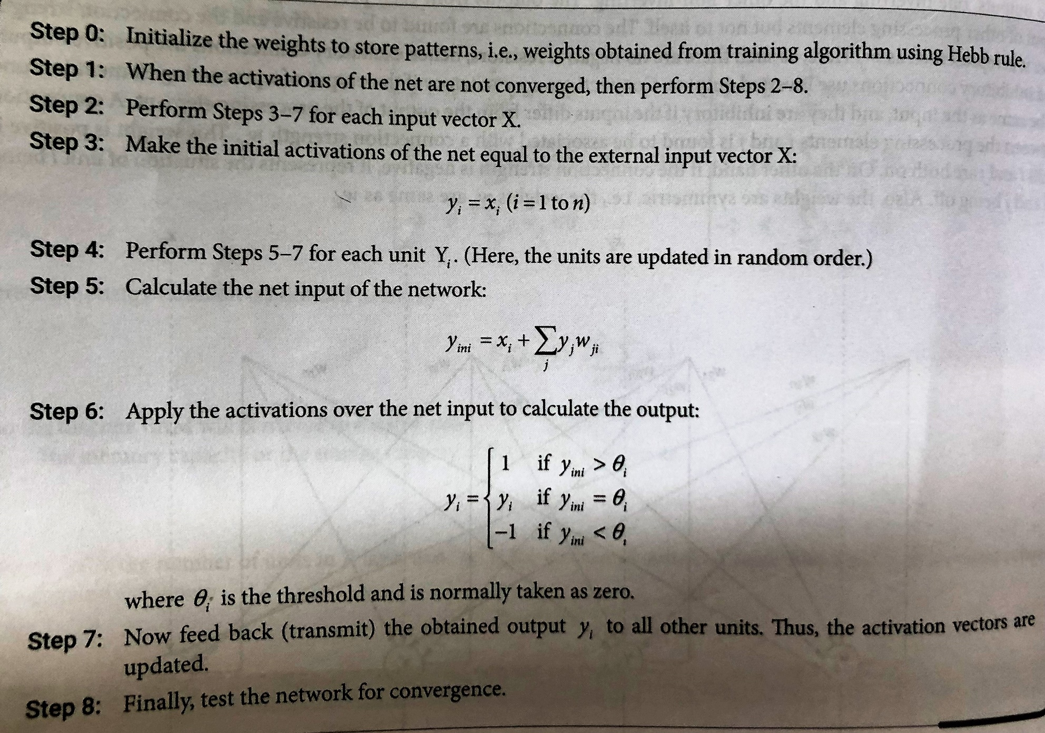
Testing Algorithm

Slide 16
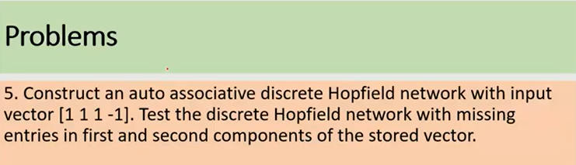

Slide 17
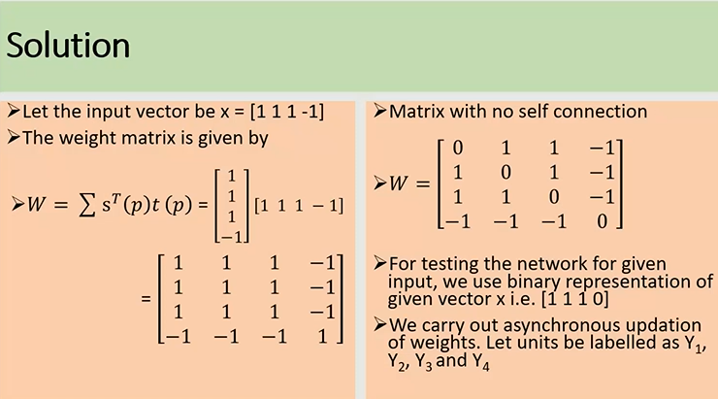

Slide 18
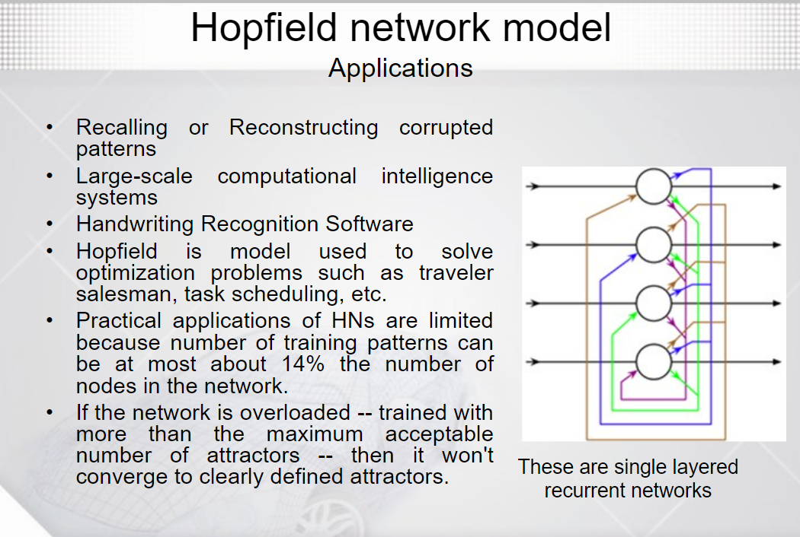

Slide 19
References
“Principles of Soft Computing, 2nd Edition” by S.N. Sivanandam & SN Deepa, Wiley India Pvt. Ltd.
Link :
https://analyticsindiamag.com/6-types-of-artificial-neural-networks-currently-being-used-in-todays-technology/

Slide 20
THANK YOU
For queries
Email: monika.e11032@cumail.in

